Slide 1

ATLIQ HOSPITALITY DOMAIN REVENUE ANALYSIS
PRESENTED By
R.Ramachandran

Slide 2
ATLIQ GRAND
AtliQ Grands owns multiple five-star hotels across India.
They have been in the hospitality industry for the past 20 years.
They Provide excellent service, luxurious accommodations and high comfort

Slide 3
AtliQ Grand
Bangalore
Delhi
Hyderabad
Mumbai
AtliQ Property
Standard
Elite
Premium
Presidential

Slide 4
Problem Statement
Due to strategic moves from other competitors and ineffective decision-making in management, AtliQ Grands are losing its market share and revenue in the luxury/business hotels category
As a strategic move, the managing director of AtliQ Grands wanted to incorporate “Business and Data Intelligence” to regain their market share and revenue.

Slide 5
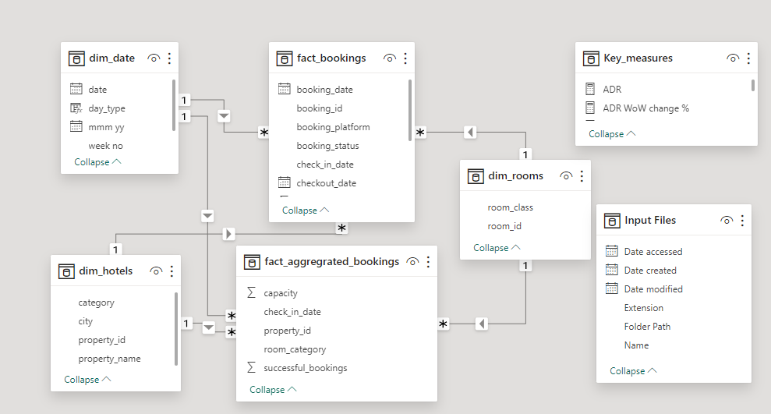
Data Modelling

Slide 6
Key Metrics
RevPAR (Revenue Per Available Room) - It represents the revenue generated per available room, If available or not they are occupied.
DBRN (Daily Booked Room Nights) - This metrics tells on average how many rooms are booked for a day considering a time period
DSRN (Daily Sellable Room Nights) - This metrics tells on average how many rooms are ready to sell for a day considering a time period
DURN (Daily Utilized Room Nights) - This metric tells on average how many rooms are successfully utilized by customers for a day considering a time period

Slide 7
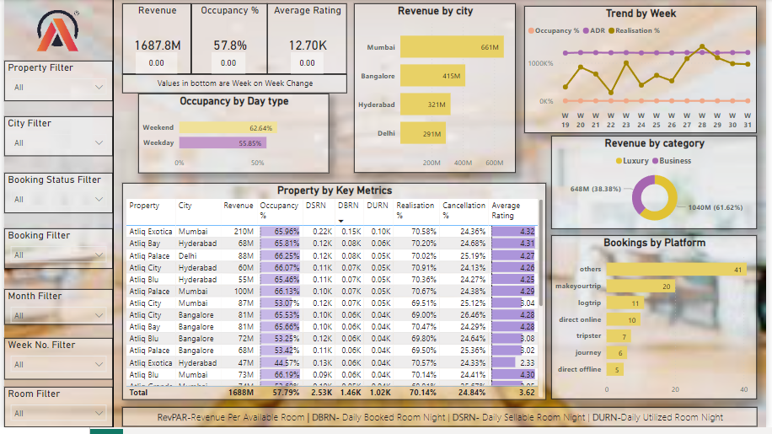
Dashboard

Slide 8
Insights
Mumbai is the top revenue generator with 669 M followed by Bangalore, Hyderabad,
Delhi.
Delhi tops both in occupancy and rating followed by Hyderabad, Mumbai, Bangalore
Week 24 had the highest revenue of all weeks at 139.6 million.
Highest Revenue generated in the month of May Which is 581.9M
Elite type rooms have the highest number of bookings and also a higher cancellation rate.
AtliQ lost out on around 298 million in revenue due to cancellations

Slide 9

THANK YOU

